Slide 1
The Battle of Neighbourhoods: Finding a Familiar Neighbourhood
Introduction
Human migration is the movement by people from one place to another with the intention of settling, permanently or temporarily in a new location. Early human migrants are usually a result of climate change. Though climate change is no longer severer in modern societies, there are still several causes impel migrants to move to another country. Globalization is one of the reasons people move to new places for better job opportunities
Migration is a huge event for most migrants. In addition to searching for new accommodation and a new job, migrates also need to overcome culture shocks during settle down. To have a smooth transfer in the new city, it is very desirable to move to a similar neighbourhood where the migrants lived before. For example, a coffee lover who usually needs a cup of coffee every morning from Starbucks will prefer a place with a cafe nearby. I would like to use the Foursquare location data to analyze the neighbourhoods of eleven different cities across the world. These cities are the economic or political centre of the countries. I wish to find similar neighbourhoods among these cities and provide some useful information for people who are considering moving among these places.
PIYUSH DEEP

Slide 2
Data
The neighborhood data of New York is provided here: https://geo.nyu.edu/catalog/nyu_2451_34572
The neighborhoods of Toronto are extracted from here: https://en.wikipedia.org/wiki/List_of_postal_codes_of_Canada:_M
The neighborhoods of Bangalore are extracted from: https://www.indiatvnews.com/pincode/karnataka/bangalore/
The neighborhoods of Hyderabad are extracted from: https://www.indiatvnews.com/pincode/telangana/hyderabad
The neighborhoods of Mumbai are extracted from: https://www.indiatvnews.com/pincode/maharashtra/mumbai
The neighborhoods of Delhi are extracted from: https://www.indiatvnews.com/pincode/delhi
The neighborhoods of Pune are extracted from: https://www.indiatvnews.com/pincode/maharashtra/pune
The neighborhoods of Paris are extracted from: https://www.data.gouv.fr/fr/datasets/r/e88c6fda-1d09-42a0-a069-606d3259114e
The neighborhoods of London are extracted from: https://en.wikipedia.org/wiki/List_of_areas_of_London
The neighborhoods of Beijing are extracted from : https://en.wikipedia.org/wiki/List_of_township-level_divisions_of_Beijing
The neighborhoods of Shanghai are extracted from: https://en.wikipedia.org/wiki/List_of_townshiplevel_divisions_of_Shanghai
PIYUSH DEEP

Slide 3
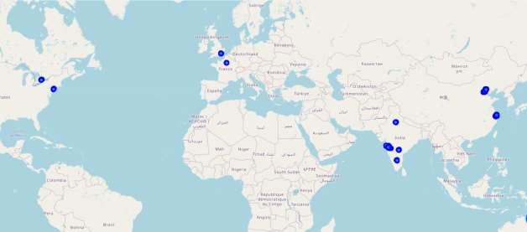
Methodology
  Data preparation
The New York data is available online with the neighbourhood name and location information (latitude and longitude). For Toronto, Bangalore, Hyderabad, Mumbai, Delhi, Pune, London, Beijing and Shanghai, only neighbourhood name is provided. Therefore, I used the Nomination library to obtain the location information by searching each neighbourhood name. A number of neighbourhoods are not found in Nomination, I didn’t include these neighbourhoods in my analysis. For Paris, the data is available on two different links which I combined together to get all the required information for the analysis. For the data scraping from various websites, I used the Beautifulsoup package.
PIYUSH DEEP
FIG. 1. Here is the visualization of all the eleven places that we are going to analyse this project to find the similarity among these places.

Slide 4
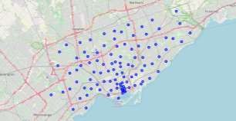
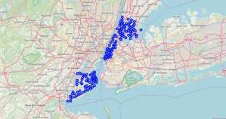
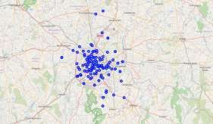
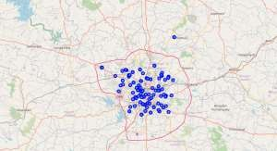
FIG. 2. Map of (a) Toronto, (b) New York
FIG. 3. Map of (a) Bengaluru, (b) Hyderabad
PIYUSH DEEP

Slide 5
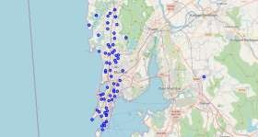
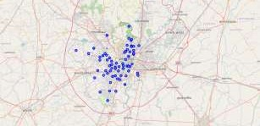
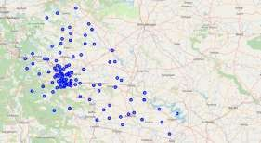
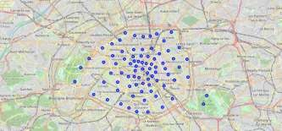
FIG. 4. Map of (a) Mumbai, (b) Delhi
FIG. 5. Map of (a) Pune, (b) Paris
PIYUSH DEEP

Slide 6
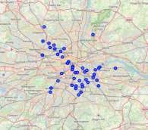
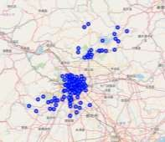
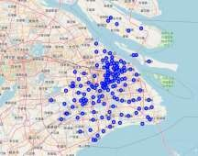
FIG. 6. Map of (a) London, (b) Beijing, (c) Shanghai
PIYUSH DEEP

Slide 7
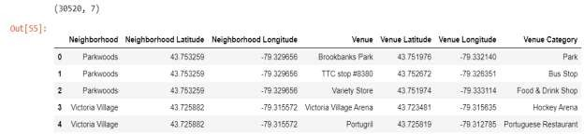
3.2 Data acquisition
I utilized the Foursquare API to explore the boroughs and segment them. It was used to search for nearby venues of each neighbourhood in radius of 500 meters for each borough from their given latitude and longitude information. Only the venues name and venues category (i.e. café, restaurant, school, etc.) are extracted. In the whole combined dataset of all the neighbourhood of eleven places, a total of 30520 relevant venues were found with their coordinates.
Here is a head of the list Venues name, category, latitude and longitude information from Foursquare API.
After obtaining all the venues, the total number of venues in each category is counted for each neighbourhood and also the total number of unique venues that summed to 539 unique categories.
To further analyse, I also build a table with top 10 most frequent venue categories for each neighbourhood.
PIYUSH DEEP

Slide 8
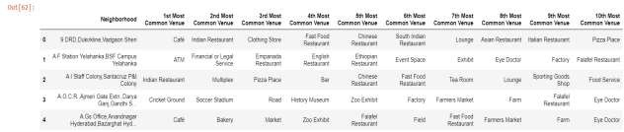
3.3 Machine Learning Uses
For segmenting neighbourhood in the dataset of all the eleven places around the world based on their similarities with each other to find recommendation for a familiar neighbourhood for the person moving from one place to another, clustering algorithm will be used especially K-mean method. This method is used as unsupervised algorithm. It doesn’t need previous recommendations to build a model. K-mean method is good for segmentation. It divides the data into clusters without any cluster-internal structures or label.
The number of clusters was decided to be 14, after checking the Elbow Method and Silhouette Coefficients.
PIYUSH DEEP

Slide 9
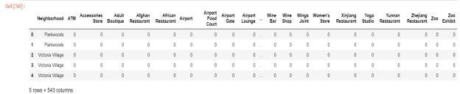
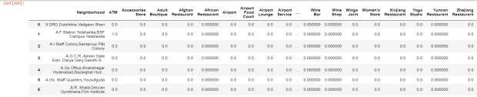
3.4 Data Analysis
I used python Folium library to visualize geographic details of all these places and its boroughs and I created a map of these places with boroughs superimposed on top. I used latitude and longitude values to get the visuals.
To analyse the data of the different categories of the venues of various neighbourhood, one hot encoding was done.
Next, I grouped the rows by neighbourhood and by taking the mean of the frequency of occurrence of each category.
PIYUSH DEEP

Slide 10
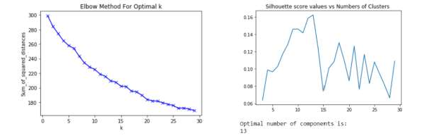
According to our problem statement, it is clear that this analysis required unsupervised learning and it has unlabelled dataset, thus it would likely to be required to be clustered. Therefore, to segment the neighbourhood in the dataset of all the eleven places around the world based on their similarities with each other to find recommendation for a familiar neighbourhood for the person moving from one place to another, clustering algorithm will be used especially K-mean method. This method is used as an unsupervised algorithm. It doesn’t need previous recommendations to build a model. K-mean method is good for segmentation. It divides the data into clusters without any cluster-internal structures or label.
The number of clusters was decided to be 13, after checking the (a)Elbow Method and (b)Silhouette Coefficients as seen in the figures given below.
PIYUSH DEEP

Slide 11
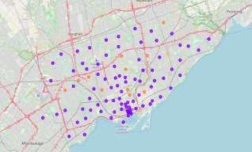
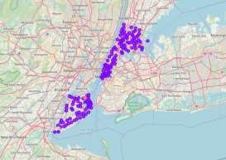
Results
  4.1 Total number of neighbourhoods in each cluster
Let’s look at the total number of neighbourhoods in each cluster to make sure they are properly clustered.
Cluster Number | 0 | 1 | 2 | 3 | 4 | 5 | 6 | 7 | 8 | 9 | 10 | 11 | 12
Total number of neighbourhoods | 12 | 836 | 13 | 17 | 18 | 8 | 33 | 4 | 66 | 67 | 124 | 33 | 9
Table.1 Total number of neighbourhoods in each cluster.
  4.2 Map visualization of the clusters
    Cluster City Maps
Here is the visualization of all the places that we are analysing after the clustering was done.
FIG. 7. Map of (a) Toronto, (b) New York
PIYUSH DEEP

Slide 12
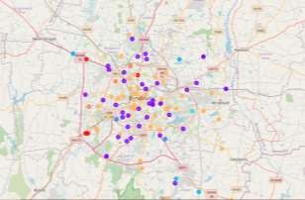
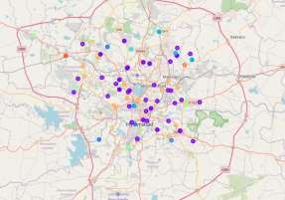
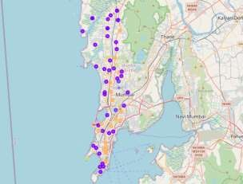
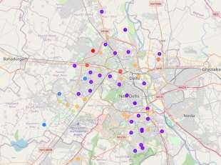
FIG. 8. Map of (a) Bengaluru, (b) Hyderabad
FIG. 9. Map of (a) Mumbai, (b) Delhi
PIYUSH DEEP

Slide 13
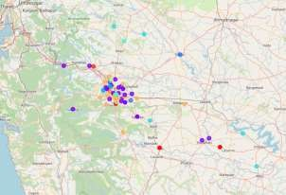
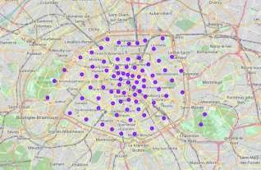
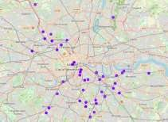
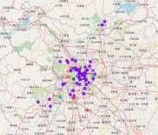
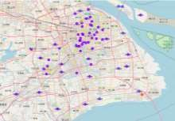
FIG. 10. Map of (a) Pune, (b) Paris
FIG. 11. Map of (a) London, (b) Beijing, (c) Shanghai
PIYUSH DEEP

Slide 14
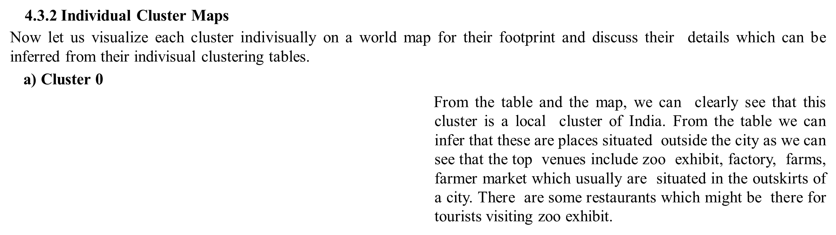
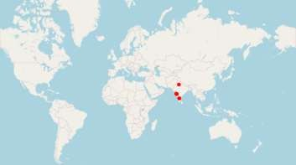
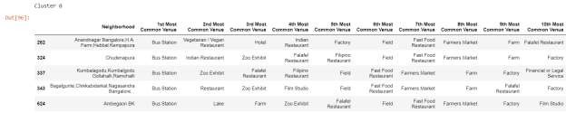
PIYUSH DEEP

Slide 15
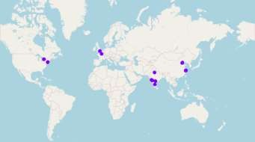
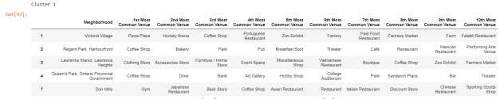
b) Cluster 1
Here from the table and the map, we can infer that this is a universal cluster. From the table we can see that these are places situated in the middle of the cities. There are pizza places, cafes, coffee shops, various type of stores, art galleries, theatre, parks, pubs, gym, restaurants etc. So, this cluster provides places to move into the hustle and bustle of the centre of a city.
PIYUSH DEEP

Slide 16
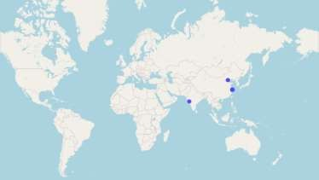
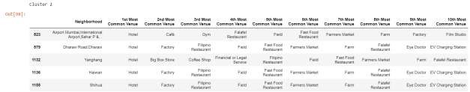
c) Cluster 2
From the map and the table, we can see that this is a cluster that belong only to Indian and Chinese cities. From the table, it seems to include places near highways on the outskirts of a city. This is because it has hotels as well as farms, farmers market and factories which generally are situated outside city. There are some restaurant options for the people staying in the hotels.
PIYUSH DEEP

Slide 17
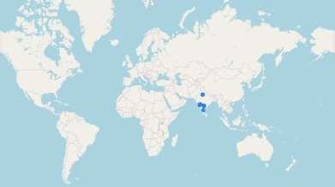
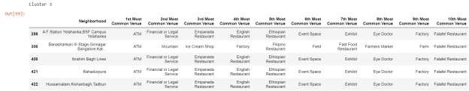
d) Cluster 3
From the map and the table, this cluster also seems clearly to be a local cluster of Indian cities. Places in these are most probably situated inside the cities as there are ATMs, legal services, restaurants, eye doctors which usually are essential services inside a city. Its not very clear though because there are also factories in these clusters, so maybe these are small factories allowed within city limits.
PIYUSH DEEP

Slide 18
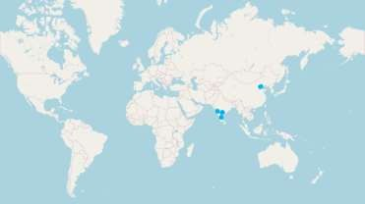
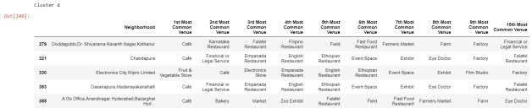
e) Cluster 4
This cluster also seems to be a local cluster of Indian and Chinese cities as seen in the map and the table. These places seem to be inside city boundaries and also located probably in the centre of the city as there are various restaurants, cafes, exhibits, eye doctors, market and stores.
PIYUSH DEEP

Slide 19
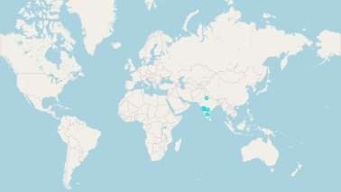
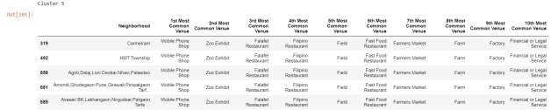
f) Cluster 5
From the table and the map, we can clearly see that this cluster is a local cluster of India. From the table we can infer that these are places situated outside the city as we can see that the top venues include zoo exhibit, factory, farms, farmer market which usually are situated in the outskirts of a city. There are some restaurants which might be there for tourists visiting zoo exhibit.
PIYUSH DEEP

Slide 20
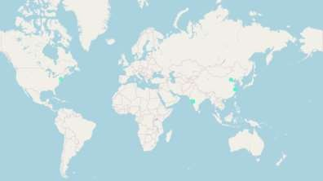
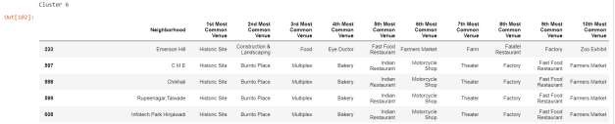
g) Cluster 6
Here from the table and the map, we can infer that this is a universal cluster. From the table we can see that these are places situated around some historical sites.
There are burrito places, theatre, restaurants, multiplex, bakery, etc. which indicates that these are mostly tourist places.
PIYUSH DEEP

Slide 21
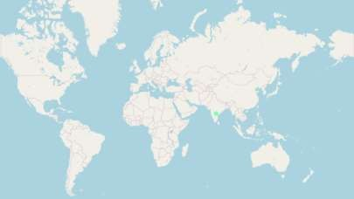
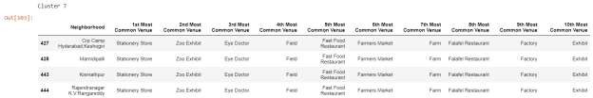
h) Cluster 7
This clearly is an outlier cluster only including places of Hyderabad, India. It has only 4 neighbourhood assigned to it. It is mostly situated outside the city as it has zoo exhibit, factories and farms.
PIYUSH DEEP

Slide 22

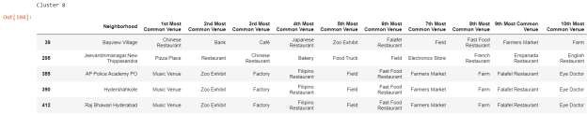
i) Cluster 8
Here from the table and the map, we can infer that this is a universal cluster. From the table we can see that these includes places which are situated around some public event areas like music venues, zoo exhibits and have various restaurants and also farms. So mostly these are tourist places and are situated on the outskirts.
PIYUSH DEEP

Slide 23
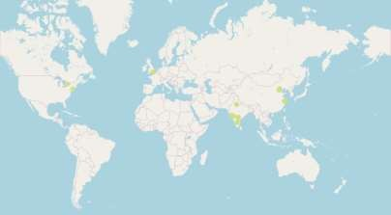
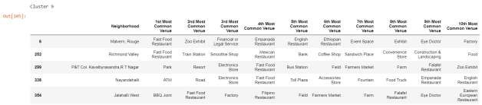
j) Cluster 9
Here from the table and the map, we can infer that this is a universal cluster. From the table we can see that these are places situated in the middle of the cities. There are restaurants, bbq joint, resorts, stores, fast food restaurants, bank, coffee shops, etc. So, this cluster provides places to move into the hustle and bustle of the centre of a city.
PIYUSH DEEP

Slide 24
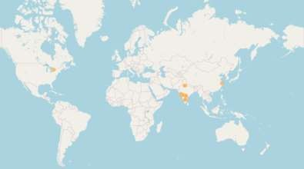
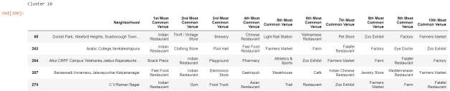
k) Cluster 10
Here from the table and the map, we can infer that this is a universal cluster. From the table we can see that these are places situated in the middle of the cities. There are restaurants, snack place, playground, stores, fast food restaurants, doctors, gym, etc. So, this cluster provides places to move into the hustle and bustle of the centre of a city.
PIYUSH DEEP

Slide 25


l) Cluster 11
Here from the table and the map, we can infer that this is a universal cluster. From the table we can see that these are places situated in the middle of the cities. There are restaurants, park, bars, event space, stores, fast food restaurants, field, doctors, etc. So, this cluster provides places to move into the hustle and bustle of the centre of a city.
PIYUSH DEEP

Slide 26


m) Cluster 12
From the table and the map, we can clearly see that this cluster is a local cluster of Indian and Chinese cities. From the table we can infer that these are places situated outside the city as we can see that the top venues include zoo exhibit, factory, farms, farmer market which usually are situated in the outskirts of a city. There are some restaurants which might be there for tourists visiting zoo exhibit.
Therefore, by observation of each cluster carefully, we can see that
- cluster 0, 3, 5 and 7 are local clusters of Indian cities.
- cluster 2, 4, 6 and 12 are clusters common among Indian and Chinese cities.
- cluster 6 is full of Historic Site, Multiplex, Theatre, Restaurant and other food shops so basically looks like a tourist place.
- rest all clusters, 1, 6, 8, 9, 10 and 11 are universal.
PIYUSH DEEP

Slide 27
5. Conclusion
Therefore, from the analysis, we can conclude that if someone wants to move locally within India, then they can get help from the local clusters 0, 3, 5 and 7. Or if someone wants to move between Indian and Chinese cities, then they can get help from the clusters 2, 4, 6 and 12. And finally, for moving across countries one can find guidance from the other universal clusters that are 1, 6, 8, 9, 10 and 11.
We can also see that the clusters are also assigned based upon its location like within city limits, on the outskirts of city or exactly in the middle of the hustle and bustle of a city life. Therefore, for those who are looking for a good residential area to settle down or for those who have a job in the city centre and don’t want to spend much time on transportation or for those who wants to settle down on the outskirts of a city life for a quite and peaceful life, everyone can take help from these analysis and the assigned the clusters to find an optimum place for themselves.
The following analysis also convince that despite the distinct cultural and geographical location differences of all these cities, there are several similar neighbourhoods among them. Therefore, I hope that this could provide some insight for the people who are considering moving among these countries.
Thank you for reading!
PIYUSH DEEP

